Slide 1


Aegle COMPANION FOR HEALTHY LIFE
Kay Gillmann
Kevin oh
Lucy Liu
Sebastian Zawadzki
Tam Tran

Slide 2
TABLE OF CONTENT
Introduction and business opportunity
Positioning and stakeholder
Use case
Non-fuctional requirements
Notes:
1. Kevin 2. Tam 3. Kay 4. Lucy 5. Sebastian

Slide 3
VISION - INTRODUCTION
We envision a next generation, social, all-in-one smart fitness companion application
Aegle is designed to have the flexibility to be useful for anyone interested in fitness
Aelge containing multiple user interface mechanisms supported by a variety of devices intuitively
This system will provide a convenient way for users to start and maintain a regular exercise program, along with a proper diet

Slide 4
VISION - INTRODUCTION
Aegle is integrated with its own social media platform
Users will be able to share their personal achievements and milestones, along with the ability to fit in with others in your own niche of the health community
The greatest advantage of the social media platform is the ability for users to share their workout programs and recipes
Other users can try them out and leave reviews
The most popular workouts and recipes will then be showcased and recommended to users

Slide 5
VISION - INTRODUCTION
WHY?
Doing this will ensure that Aegle will always have the best information available to our users

Slide 6
VISION - POSITIONING
Business opportunity: A recently published study found that only 2.7% of U.S. adults live a healthy lifestyle
A significant part of living a healthy lifestyle comes from fitness and diet
Almost anyone could benefit from eating a better diet and being more active
Yet the number of healthy people is so low because of the barriers to getting fit, such as the time, money, and know-how required

Slide 7
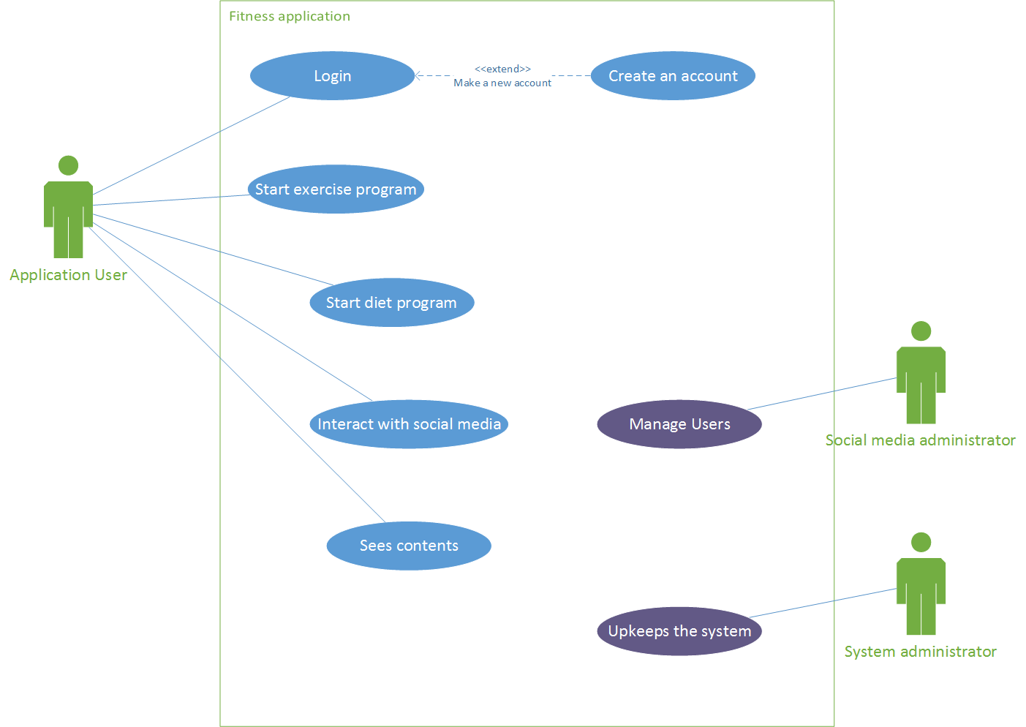
USE CASE - DIAGRAM

